Slide 1



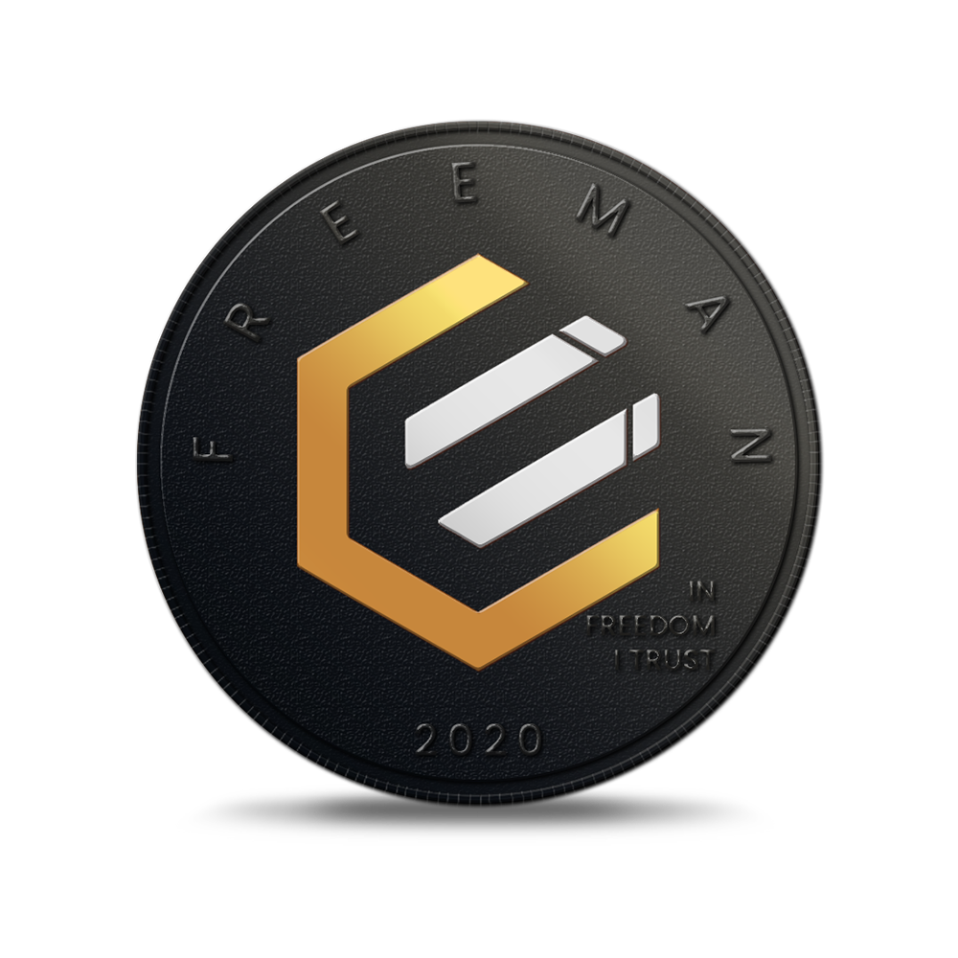
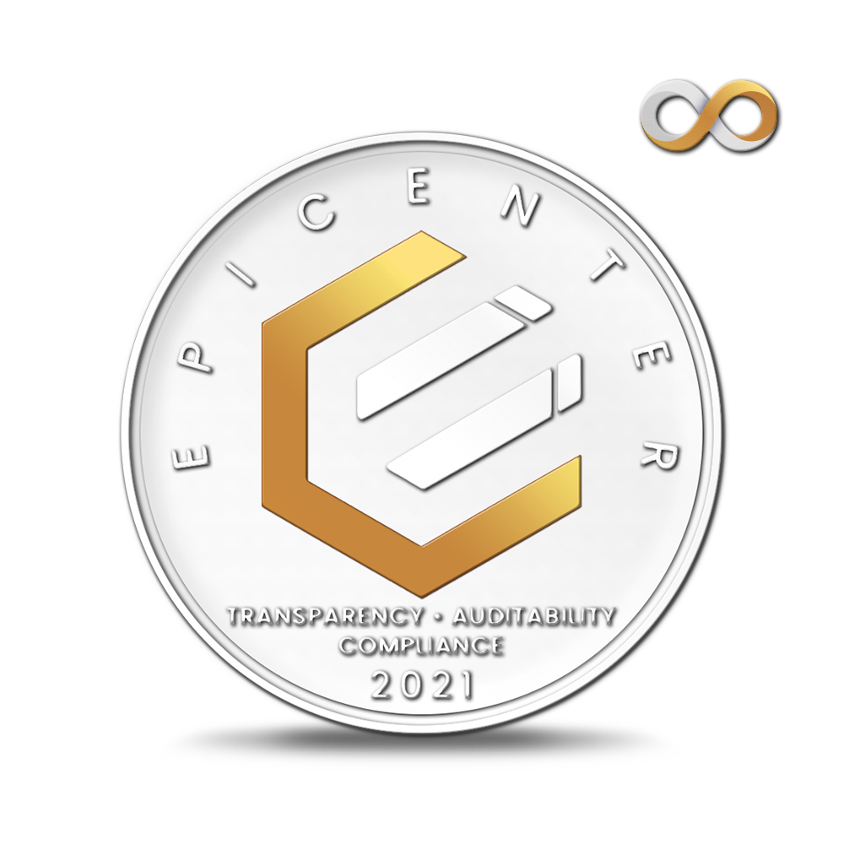
An introduction to ECR
THE EPICENTER ECOSYSTEM
EC210701 – ECR Introduction v04

Slide 2
Introduction
BITCOIN FOR THE MASSES
Cryptocurrencies in general, and Bitcoin (BTC) in particular, have proven to be massively successful when it comes to maintaining a store of value.
Despite all the volatility in the dollar price, the overall trajectory has been quite clear. We expect this trend will continue as more people recognize the inflationary threat inherent in fiat currencies.
While great as a store of value, however, BTC appears to have fallen victim to Gresham’s Law when it comes to acting as a medium of exchange — it is too valuable to be used in day-to-day transactions. It has instead evolved into digital gold, held either as a speculative investment or long-term savings. Its monetary velocity is understandably low.
The starting premise of the Epicenter ecosystem was that there is real value in providing a “Bitcoin for the Masses”: i.e., a blockchain-based economic ecosystem, starting from the Bitcoin model, but optimized to appeal to small-scale users for day-to-day transactions.
A wide range of algorithm improvements have been incorporated into the open-source software to allow low-cost, secure, peer-to-peer transactions, either in crypto or fiat equivalent, across a decentralized network.

Slide 3
Overview
The Epicenter ecosystem provides the solid monetary platform that decentralized finance requires. Within this framework, anyone, anywhere, can create secure, scalable, globally accessible financial services in minutes. Epicenter dramatically lowers the barriers to entry, for both producers and consumers of such apps.
"Composability" is a relatively recent buzzword that is taking center stage, and for good reason. When components are modular and reusable, free of the friction of sign-up processes and the need to maintain an ongoing connection between parties, innovators are able to experiment in novel ways to solve client needs at low risk.
There are 1.7 billion people around the world who have smartphones and yet lack access to basic financial services. All of these individuals can benefit immediately from the DeFi apps that are able to make use of the Epicenter ecosystem.
Security, scalability and decentralization — it is no longer necessary to settle for only two. By weaving the strengths of multiple independent blockchains together into one robust fabric, the Epicenter triumvirate of EPIC/ECR/EUSD confidential, composable, interoperable digital assets is moving the world's financial interactions on chain without compromising on custody, centralization, censorship, permissionlessness or trustlessness.
THE EPICENTER ECOSYSTEM.

Slide 4
The Epicenter Ecosystem
Composable Components
ECR
ECR is the governance token of the Epicenter ecosystem.
Like the MKR token under the Maker Protocol, the ECR token is instrumental in maintaining the value of the Epicenter stablecoin, EUSD. Holders of the ECR token are the trustees for the Epicenter ecosystem in that they have voting rights — one vote per token — when it comes to setting the policies and parameters that govern the system. ECR holders have skin in the game: they can expect to profit when the system is functioning smoothly, but they also assume the risk if the EUSD token comes under attack. The ECR token is diluted as necessary to maintain the EUSD soft peg.
If a user’s Epic Cash account can be considered their savings – their digital gold – then EUSD could be considered a checking account for dollar-denominated expenses. In the same vein, ECR could be thought to fill the role of the Federal Reserve for this monetary universe – it stabilizes the currency (EUSD) and the ECR holders get seigniorage and other compensation for the risk they assume. ECR is equivalent to an investment, with both risk and reward, but through their voting rights — selecting the parameters that govern the system — ECR holders can have a direct impact on their own success. They are strongly incentivized to maintain the stability of the system and are rewarded to the extent they succeed.
Note that the ECR token does not fall under the SEC regulatory structure: it is not a “security” as defined by the Howey Test since its profits are not solely derived from the efforts of others. Rather ECR holders are directly involved in the profitability of the token by choosing the goldilocks levels for all of the system parameters — not too hot and not too cold… and the incentives are structured so that ECR holders will not actually profit unless they participate in the Epicenter governance.
User deposits EPIC collateral…
…and stakes ECR tokens…
…to unlock an EUSD credit line…

Slide 5
The Epicenter Ecosystem
Composable Components
EPIC
EPIC is a novel software implementation of the original Bitcoin Standard, updated to the most recent technologies. EPIC’s Rust-based Mimblewimble blockchain includes improvements in all of the attributes that are necessary to foster mass adoption.
Epic Cash is Howey compliant, designed to attain a score of "1” by the Crypto Rating Council. Epic Cash is 100% proof-of-work mined, with no special nodes.
With a hard limit on supply, Epic Cash, like BTC, is expected to function as a store of value. As a medium of exchange, however, both Epic Cash and BTC have a serious problem: their value, as measured in fiat, fluctuates wildly.
EUSD
Any enterprise with a dollar-denominated cost structure would have to swallow the exchange-rate risk if they accepted a cryptocurrency in payment. With the current level of exchange rate volatility, this generally makes cryptocurrencies unsuitable for doing business in the fiat world.
This is the whole function of the EUSD stablecoin, which will launch under the Epicenter umbrella Q1 2022: one EUSD token is always and instantly redeemable for $1 worth of Epic Cash. EUSD is multi-chain and will eventually be available on 31 other blockchains such as DAI, Solana, Kadena, Avalanche, and more.
An EUSD holder is always guaranteed $1 worth of EPIC, regardless of the current print. Unlike Federal Reserve Notes or DAI, EUSD accrues no interest.
1 EUSD = $1
worth of
EPIC

Slide 6



The Epicenter Ecosystem
Composable Components
EONE
Access Turing complete smart contract platforms in a trustless, permissionless way using EONE tokenized EPIC using technology from secure MPC networks such as RenVM & Wanchain.
Unlike EUSD which is soft pegged to $1 worth of EPIC, EONE is hard pegged to 1 EPIC. In this way, arbitrage opportunities exist for independent market actors to proactively move liquidity between chains as necessary.
1 EONE
=
1 EPIC

Slide 7
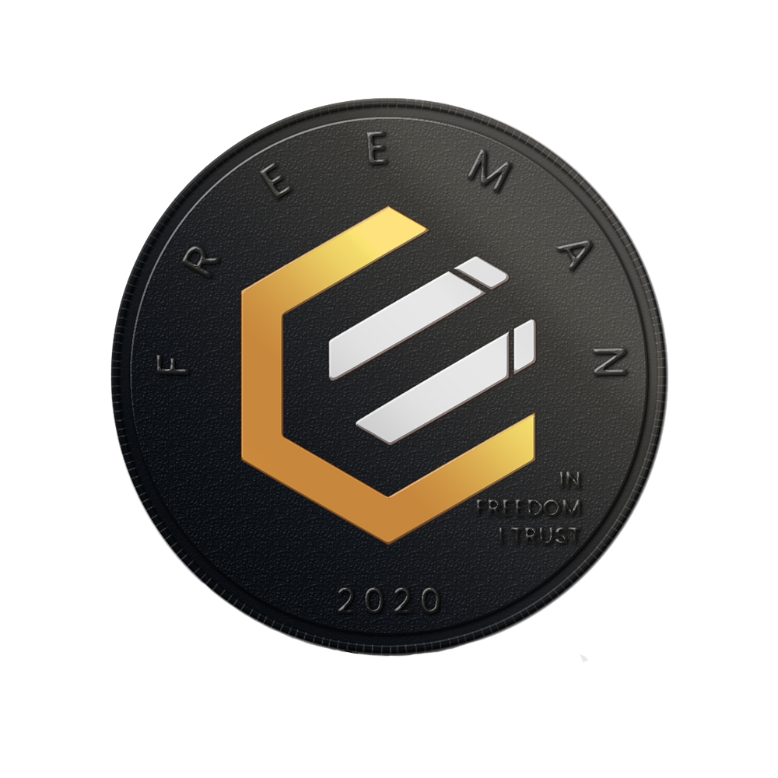
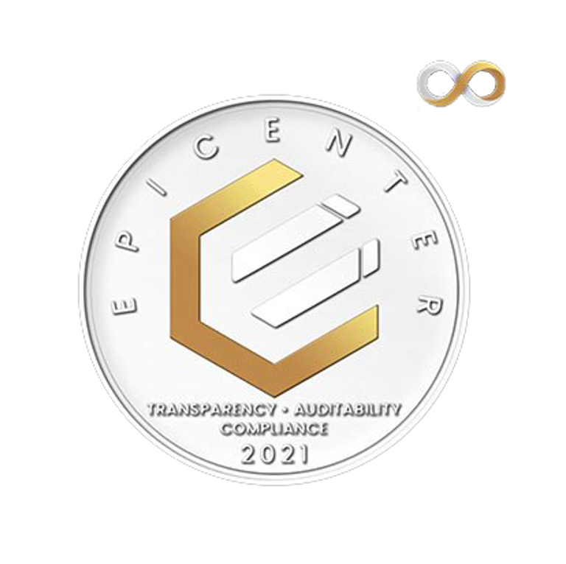



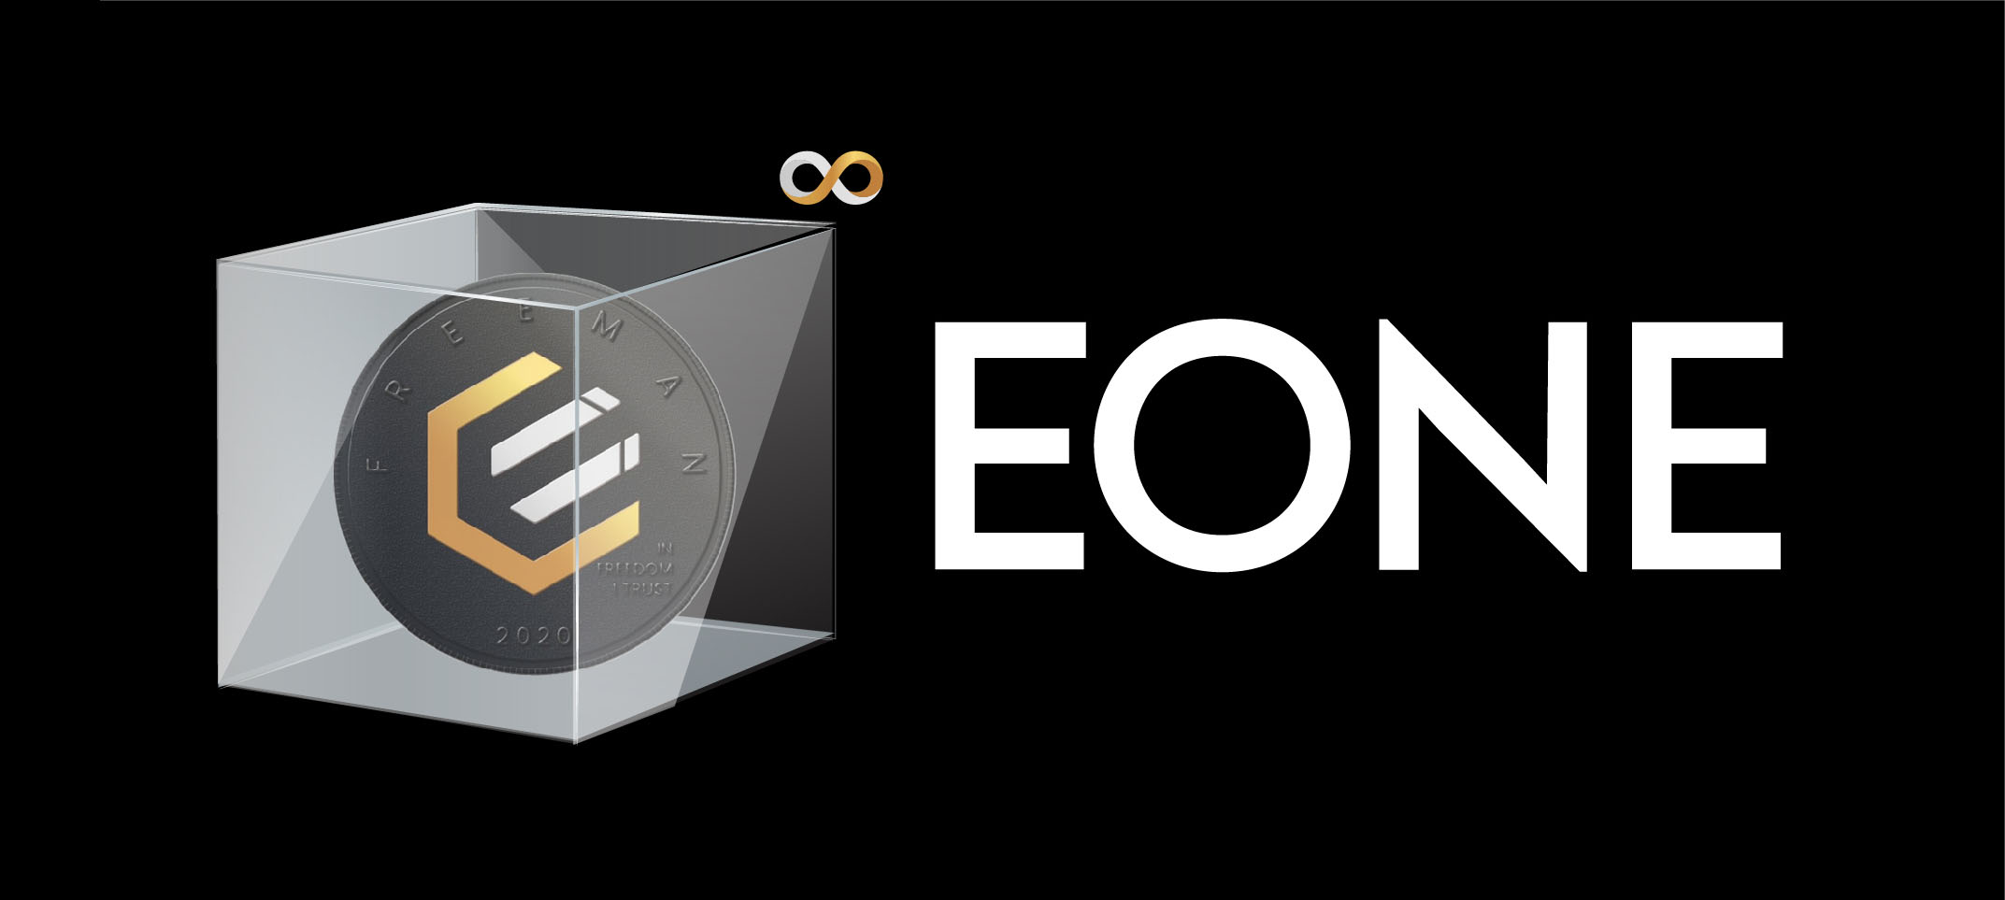
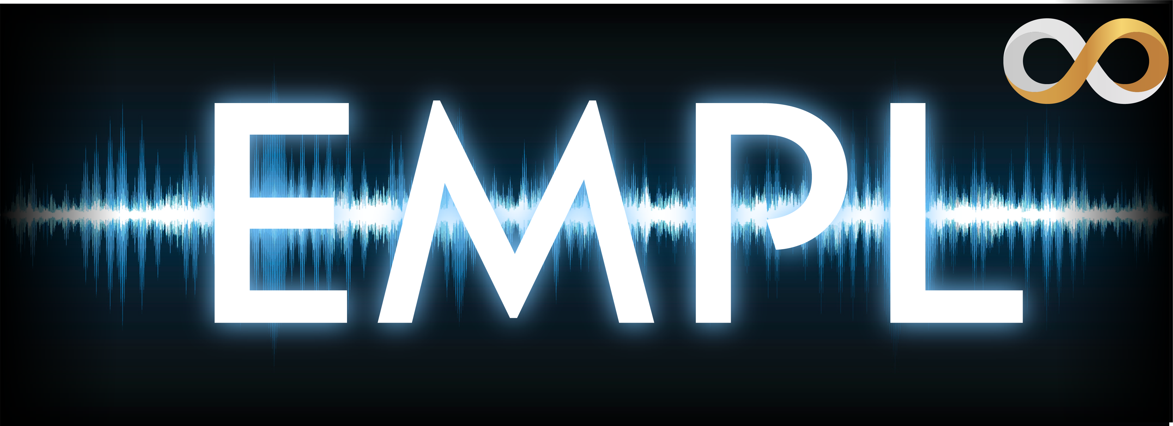

The Epicenter Ecosystem
Composable Components
EPIC CASH: Fungible P2P digital cash
EPICENTER USD: Transparent, compliant, auditable notes
STORE OF VALUE
UNIT OF ACCOUNT
EUSD is soft pegged to $1 worth of EPIC
MEDIUM OF EXCHANGE
Smart contracts
Elastic supply mechanism cross-stabilizes
Savings
Lending & Investment
One EONE = redeemable on demand for 1 EPIC as a hard peg.
Liquid marginable collateral
STAKING + YIELD FARMING
P2P trade decentralized exchange
With EPIC / ECR / EUSD as the core, decentralized financial applications can be created by anyone.
Epicenter protocols are modular, composable, and interoperable components that enable independent builders to go to market fast and scale without worrying about their underlying infrastructure.

Slide 8
The ECR Token
Unstoppable money
Why is EPIC unstoppable?
Censorship Resistance, Confidentiality, Permissionlessness
Censorship Resistance
Censorship resistance means in this context that no one can interfere with your access to the network. The network itself cannot be shut down, as it relies on true distributed consensus, meaning that as long as one copy of the software exists somewhere, the network will instantly spring back to life after a disruption.
Confidentiality
What does confidentiality have to do with censorship resistance? In BTC for example, the network can accept a transaction as valid, yet the individual coins themselves may be designed as illicit/tainted and therefore be blocked / blacklisted by a counterparty or intermediaries. An additional off-chain social consensus layer is required to maintain the notion of which coins are clean and which are dirty. The EPIC Blockchain protocol encrypts all transactions such that it is impossible to discriminate against particular coins - all are identical.
Permissionlessness
If people require permission to use a network, then if that permission is not forthcoming, it is an effective vector of censorship. EPIC is designed for direct operation by individuals using only free open-source software. Terms of service agreements cannot be used to restrict network access.
Scarcity
Yield
Elasticity
CONFIDENTIALITY
COMMUNITY
TRANSPARENCY
EPIC : ECR : EUSD
…that can’t ever be seized, frozen or blacklisted by anyone.
IS UNSTOPPABLE MONEY…

Slide 9




The ECR Token
Secure, scalable and decentralized
Secure
Full Nakamoto Consensus - 100% proof of work mined, no special nodes. Relying on technical, social, and game theoretical forces to maintain security as it does, the BTC network is the most secure system in existence. This is why the design of EPIC carries the structure over wholesale. The only changes made increase rather than degrade security, namely:
Freeman Proof of Work
The ability of the world to produce computation for BTC is bottlenecked and gated by the need to secure the appropriate hardware. Only latest-generation SHA256 ASICs can do the work necessary to earn the coins. In EPIC, any hardware will do. Today, you can plug in an old laptop and generate a 24/7 passive income mining 60% of the time on its CPU thanks to RandomX. If you have a graphics card, you can run it 38% of the time on ProgPow. EPIC mining is predominantly practiced on otherwise-idle equipment that would be underutilized, turning a cost center into a revenue generator that contributes directly to the bottom line.
Economic Attack Resistance (51% etc)
Game Theory - The Bitcoin design relies on the notion that a rational attacker would prefer to earn more money rather than less, which is usually the case. EPIC takes this to the next level in a number of ways. Specifically, because it uses a heterogeneous algorithm design, an attacker must successfully muster not just 51% of a single algorithm, but all of them. The attacker does not know ahead of time which algorithm is needed because it is random. By needing to juggle many more moving parts, the risk/reward ratio of an attack is skewed in favor of the defender, requiring much more resources to attack successfully than would otherwise be the case.
EPIC: FAIR LAUNCHED
100% PoW Mined
NO ICO
NO PREMINE
NO VC’s
NO COMPANY
EPIC: Howey Safe
EUSD: Stable Act Safe
ECR: Howey Safe

Slide 10
The ECR Token
Secure, scalable and decentralized (cont.)
Long & Short-Term Economic Security
Proponents of BTC maximalism argue that, thanks to the significant sunk costs invested in ASIC hardware that has no other use, that this lock-in will somehow cause people to keep mining when they otherwise wouldn’t. However, upon inspection this argument appears flawed. Irrespective of the hardware used to do it, rational miners will mine when they can earn more than $1 of coin for less than $1 worth of energy cost. This is because they are commercial operators engaged in the business of mining, for the purpose of earning a profit for shareholders. Contrast this with the nature of EPIC miners: people who have idle computing capacity they don't mind sharing with others to help secure the network. They weren't using the equipment anyway, and the coins earned are just a bonus. This is a much more sustainable and low-cost way to achieve a Bitcoin market structure.
Scalable
Full chain only 1.6GB. Even at BTC-level usage, data footprint is ~90% lower - 25GB vs 300+GB. By off loading computation to other general-purpose smart contract chains such as Ethereum, Polkadot, Solana, Kadena, and Tezos, as well as engaging distributed ledgers such as Stellar, the network possesses essentially infinite scalability.
Decentralized
Mining is currently spread across CPU, GPU, industrial ASIC today, proving out the multi-algorithm model in production. In future, mobile devices, AI TPU chips, set-top boxes, USB form factor mini-ASICs, and more can all be brought into service to help secure the network and distribute computation.
ETH CHAIN FILE 7TB
EPIC CHAIN FILE 1.6GB
BTC CHAIN FILE 300GB
25GB
EPIC with equivalent throughput
50GB

Slide 11
The ECR Token
How ECR interacts with EPIC & EUSD
Pays stability fee to
Increases utility for
Collateralizes
Extends utility of…
Provides base layer security to
Insures from black swan risk
EUSD Soft-pegged stable coin
ECR: Algorithmic central reserve
EPIC: Censorship resistant store of value with no counterparty risk
The bedrock of this system is the Epic Cash coin launched as a digital store-of-value in 2019 under the ticker symbol, EPIC.
To make use of EPIC’s digital store of value in making real world transactions, the Epicenter protocol specifies a paired “stablecoin” token, called EUSD.
To ensure that the EUSD maintains its soft peg to the US dollar, the Epicenter protocol further specifies a third token – the “governance token” for the system – to trade under the ticker, ECR. Similar to EUSD, ECR trades on the public Ethereum blockchain.

Slide 12
The ECR Token
ECR emissions
8.88B
25M
T0 7/21
3 mo.
T1 11/21
20 mo.
T2 7/23
26 mo.
T3 9/25
33 mo.
T4 6/28
Initial 25M beneficiaries
Protocol inflation beneficiaries

Slide 13
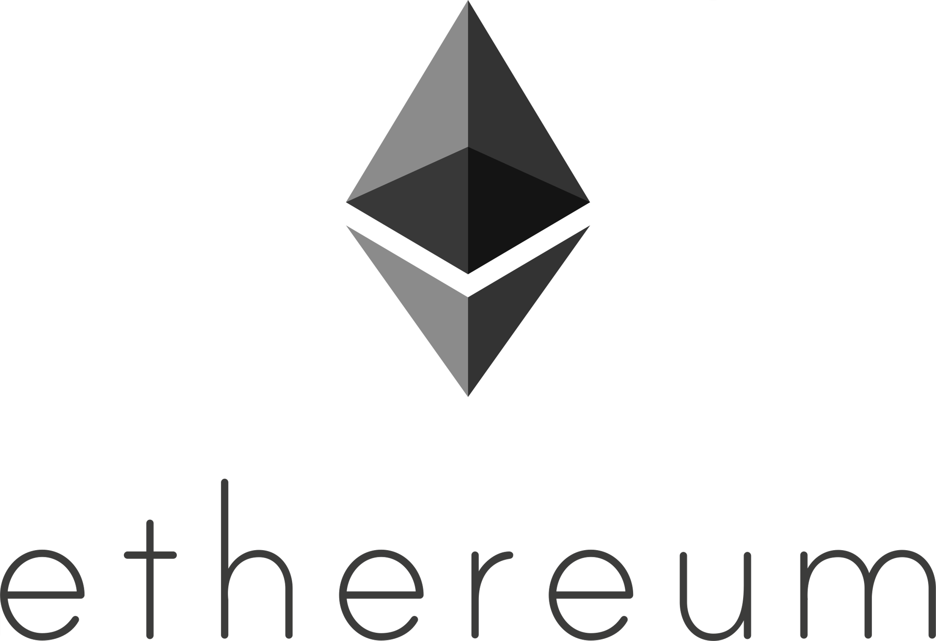




The ECR Token
Networks
Initial support
Initial Ethereum layer two networks

Slide 14

Learn more…
ECR & EUSD are free open-source software standards put forth by the Epicenter DAO.
Learn more on the Epicenter Website
Chat with the Epicenter team on Telegram
https://epicenter.epic.tech
https://t.me/EpicCash
EC210701 – ECR Introduction v04

